Slide 1

I/O Management and Disk Scheduling
Chapter 11

Slide 2
Categories of I/O Devices
For Human interaction
  Used to communicate with the user
  Printers
  Video display terminals
    Display
    Keyboard
    Mouse
Machine readable
  Used to communicate with electronic equipment
  Disk and tape drives
  Sensors
  Controllers
  Actuators
Communication
  Used to communicate with remote devices
  Modems, Network cards, etc.

Slide 3
Differences in I/O Devices
Data rate
  May be differences of several orders of magnitude between the data transfer rates
Application
  Disk used to store files requires file-management software
  Disk used to store virtual memory pages needs special hardware and software to support it
  Terminal used by system administrator may have a higher priority

Slide 4
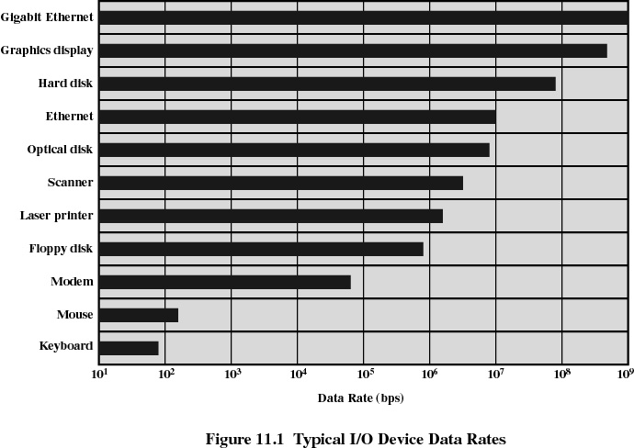

Slide 5
Differences in I/O Devices
Complexity of control
Unit of transfer
  Data may be transferred as a stream of bytes for a terminal or in larger blocks for a disk
Data representation
  Encoding schemes
Error conditions
  Devices respond to errors differently

Slide 6
I/O Control Methods
Programmed I/O
  one byte/word at a time
  uses polling ➔ wastes CPU cycles
  suitable only for special-purpose systems such as ATMs
Interrupt-driven I/O
  many I/O devices use this approach as a good alternative to polling whenever it is needed
Direct Memory Access (DMA)
  For block transfers
  minimun CPU participation (only at the beginning and at the end)
Channel I/O
  large mainframes with many users
  multiple I/O channels handled by I/O processors

Slide 7
Direct Memory Access
Takes control of the system from the CPU to transfer data to and from memory over the system bus
Only one bus master; usually the DMA controller due to tight timing constraints.
Cycle stealing is used to transfer data on the system bus. i.e. the instruction cycle is suspended so that data can be transferred by DMA controller in bursts. CPU can only access the bus between these bursts
No interrupts occur (except at the very end)

Slide 8
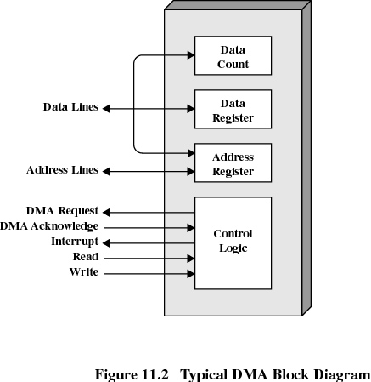
DMA
(1) Initiate Block Read
Processor
Reg
(3) Read Done
Cache
Memory-I/O bus
(2) DMA Transfer
I/O
controller
Memory
disk
disk
Disk
Disk

Slide 9
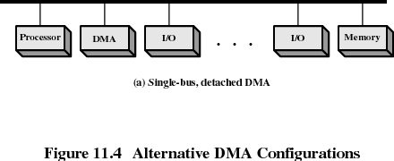
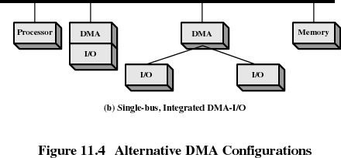
DMA

Slide 10
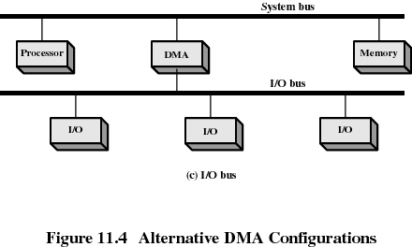
DMA

Slide 11
Operating System Design Issues
Efficiency
  Most I/O devices extremely slow compared to main memory
  I/O cannot keep up with processor speed
  Use of multiprogramming allows for some processes to be waiting on I/O while another process executes
  Swapping is used to bring in additional ready processes which itself is an I/O operation
Generality
  Desirable to handle all I/O devices in a uniform manner
  Hide the details of device I/O in lower-level routines so that processes and upper levels see devices in general terms such as read, write, open, close, lock, unlock

Slide 12
I/O Buffering
Reasons for buffering
  Processes must wait for I/O to complete before proceeding
  Those pages involved in the I/O operation must remain in main memory during I/O
Block-oriented
  Information is stored in fixed sized blocks
  Transfers are made a block at a time
  Used for disks and tapes
Stream-oriented
  Transfer information as a stream of bytes
  Used for terminals, printers, communication ports, mouse, and most other devices that are not secondary storage

Slide 13
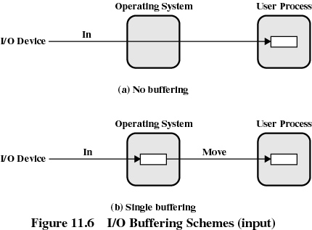
I/O Buffering

Slide 14
Single Buffer
Operating system assigns a buffer in main memory for an I/O request
Input transfers made to buffer
Block moved to user space when needed
Another block is moved into the buffer
User process can process one block of data while next block is read in
Swapping of user process is allowed since input is taking place in system memory, not user memory
T = Disk I/O Time C = Computation Time
No Buffer ➔ Time = T + C
Single Buffer ➔ Max[C,T] + M (overlap I/O with computation)
where M = time to move the data into user space

Slide 15
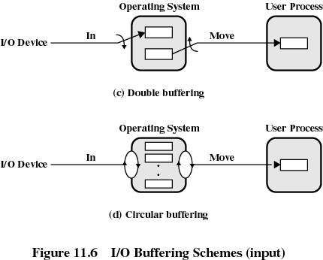
I/O Buffering

Slide 16
Double Buffer
Use two system buffers instead of one
A process can transfer data to or from one buffer while the OS empties or fills the other one
If (C + M) < T ➔ I/O device is at full speed
If (C + M) > T ➔ process does not wait for I/O
Circular Buffer
More than two buffers are used
Each individual buffer is one unit in a circular buffer
Used when I/O operation must keep up with process

Slide 17
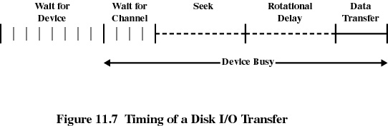
Disk Performance Parameters
To read/write, the disk head must be positioned at the desired track and the sector
Seek time: position the head at the desired track
Rotational delay (latency): time it takes for the beginning of the sector to reach the head
Access time: (seek time + rotational delay)
  The time it takes to get in position to read or write
Data transfer occurs as the sector moves under the head

Slide 18
Disk Scheduling Policies
For a single disk there will be a number of I/O requests
Seek time is the reason for differences in performance
If requests are selected randomly, we will get the worst possible performance

Slide 19
Disk Scheduling Policies
First-in, First-out (FIFO)
  Process requests sequentially
  Fair to all processes
  Approaches random scheduling in performance if there are many processes
Priority by Process (PRI)
  Goal is not to optimize disk use but to meet other objectives
  Short batch jobs may have higher priority
  Provide good interactive response time
Last-in, First-out (LIFO)
  Good for transaction processing systems
    The device is given to the most recent user so there should be little arm movement
  Possibility of starvation since a job may never regain the head of the line

Slide 20
Disk Scheduling Policies
Shortest Service Time First (SSTF)
  Select the disk I/O request that requires the least movement of the disk arm from its current position
  Always choose the minimum Seek time
SCAN
  Arm moves in one direction only, satisfying all outstanding requests until it reaches the last track in that direction
  Direction is reversed
C-SCAN
  Restricts scanning to one direction only
  When the last track has been visited in one direction, the arm is returned to the opposite end of the disk and the scan begins again

Slide 21
Disk Scheduling Policies
N-step-SCAN
  Segments the disk request queue into subqueues of length N
  Subqueues are processed one at a time, using SCAN
  New requests added to other queue when queue is processed
FSCAN
  Two queues
  One queue is empty for new request

Slide 22
Comparison of Disk Scheduling Algorithms
Name Description Remarks
(Selection according to requestor)
RSS Random scheduling For analysis and simulation
FIFO First in first out Fairest of them all
PRI Priority by process Control outside of disk queue management
LIFO Last in first out Maximize locality and resource utilization
(Selection according to requested item)
SSTF Shortest service time first High utilization, small queues
SCAN Back and forth over disk Better service distribution
C-SCAN One way with fast return Lower service variability
N-step-SCAN multiple queues
SCAN N records at a time Service guarantee
FSCAN SCAN using 2 queues Load sensitive

Slide 23
RAID
Redundant Array of Independent Disks
The rate of improvement in secondary storage performance has been much less than that of the microprocessor
In RAID, multiple independent disks operate in parallel.
(separate I/O requests can be handled in parallel or a single I/O request can be executed in parallel if the block is distributed across multiple disks. )
Also, redundancy can be added to improve reliability
(RAID 0 does not have any redundancy)

Slide 24
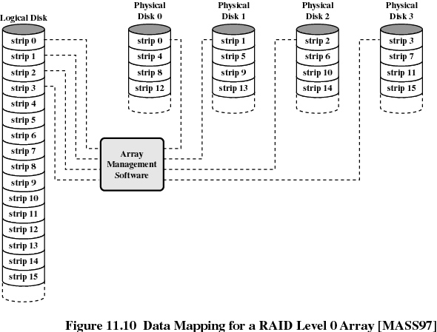

Slide 25
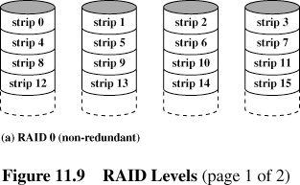
RAID 0 (non-redundant)

Slide 26
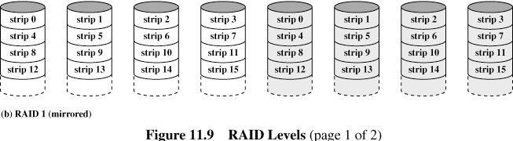
RAID 1 (mirrored)
Data stripping is used as in RAID 0
redundancy is achieved by duplicating all the data
Each logical strip is mapped to two separate physical disks
A read request can be serviced by either of the two disks
A write request requires that both strips be updated; but can done in parallel → real-time back-up
When a drive fails, data can still be accessed from the mirror disk
Disadvantage: cost is doubled
typically limited to drives that store highly critical data and system software

Slide 27
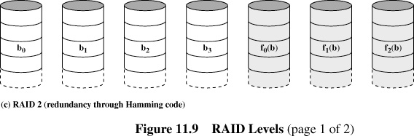
RAID 2 (error detection/correction)
The strips are small; a single byte or a word
an error-correcting code is calculated across corresponding bits on each data disk, and bits of the code are stored in the corresponding bit positions on multiple parity disks.
Typically Hamming code is used to be able to correct single-bit errors and detect double-bit errors.
Costly; only useful when disk errors are very high; since disks are pretty reliable not used in practice

Slide 28
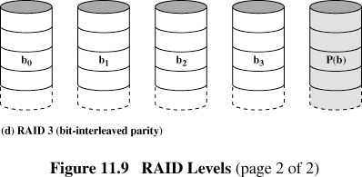
RAID 3 (bit-interleaved parity)
The strips are small; a single byte or a word
Single redundant disk
A simple parity bit is computed for the set of individual bits in the same position on all of the disks

Slide 29
Disk Cache
Buffer in main memory for disk sectors
Contains a copy of some of the sectors on the disk

Slide 30
Least Recently Used (LRU) policy
The block that has been in the cache the longest with no reference to it is replaced
IMPLEMENTATION
The cache consists of a stack of blocks
Most recently referenced block is on the top of the stack
When a block is referenced or brought into the cache, it is placed on the top of the stack
The block on the bottom of the stack is removed when a new block is brought in
Blocks don’t actually move around in main memory
A stack of pointers is used

Slide 31
Least Frequently Used
The block that has experienced the fewest references is replaced
A counter is associated with each block
Counter is incremented each time block accessed
Block with smallest count is selected for replacement
Some blocks may be referenced many times in a short period of time and then not needed any more

